Slide 1
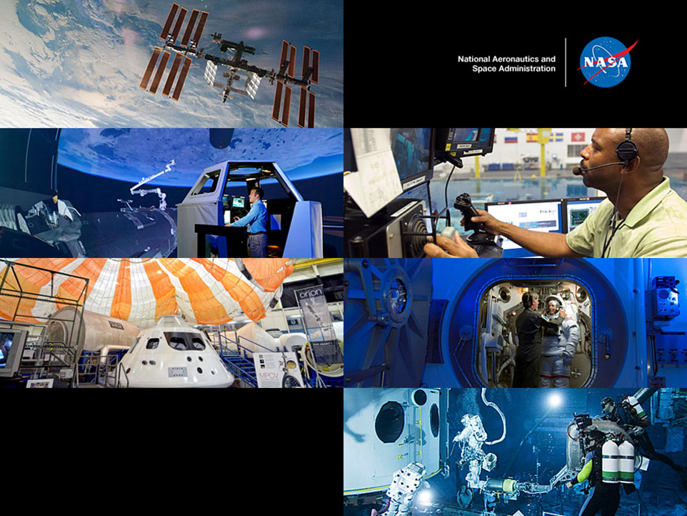
NASA JSC Co-development and Partnering Initiative
Notes:
Introduction to the presentation:
Agenda

Slide 2
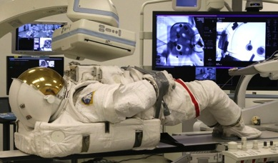
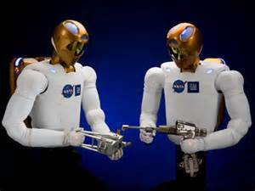
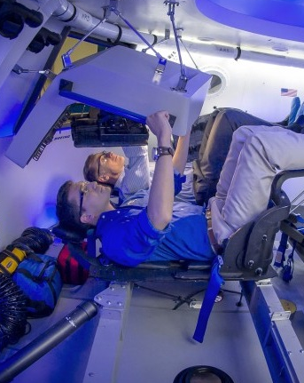
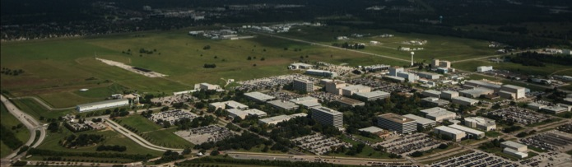

JOHNSON SPACE CENTER
PARTNERING FOR THE FUTURE
Dr. Ellen Ochoa | March 4, 2015

Slide 3



Enabling the JSC of the Future
Workforce
Cost Sharing
Technology
Development
JSC’s Deputy Center Director: “partnerships are critical to JSC’s survival and enable NASA missions”
Technology
Transfer
Commercial
Space
Strategic
Relationships
Dr. Ellen Ochoa | March 4, 2015

Slide 4
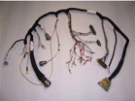
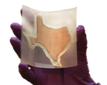
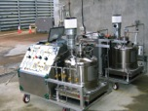
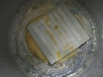

JSC’s Highly Successful Co-Development Initiative
JSC’s Co-development (Co-dev.) initiative is one of many tools that JSC’s Partnership Development Office (PDO) uses to find strategic partners from industry, academia and other Government Agencies
The goals of Co-dev partnerships are to advance technologies required for Space Exploration and/or Science
> Fill technology gaps > Find solutions in others tool boxes
> Determine current state of technologies > Expedite development time
> Avoid cost > Share resources (people, facilities, $$)
26 Co-Dev Announcements released
230+ responses
Potential
Responses Collaborations
Navigation, EDL and Aero Science 39 3
Energy production, management & storage 31 14
Propulsion 17 4
Robotics and Augmented Reality 50 4
Structures 16 6
Safety and Mission Assurance 17 2
Human Health and Performance 30 9
Aluminum Wiring Technology
Raytheon: Collaboration to advance US Industry Standards and Testing Protocol
Establishing NASA Standard for aluminum wiring could result in significant weight savings for future vehicles.
Robotics and Simulation Technologies
Osterhout Design Group (ODG): Cutting-edge wearable technology
Co-development using NASA cutting-edge Augmented Reality capabilities could result in game changing technology
Air-independent Fuel Cells
Boeing Huntington Beach: Makes fuel cells for Navy drones using jet fuel
Common technologies shared between two different fuel cell designs
Collaborate with knowledge sharing, peer review and lessons learned
Composite Sandwich Habitable Pressurized Structures
Natural Process Design Inc..: Patented Self-repairing, fiber reinforced matrix materials
Potential game changing technology
Could result in innovative structure for deep space habitats
Li-Ion Battery Technology
Big Delta Systems: Innovative technology; spray-on li-ion batteries
Potential game changing technology
Battery essentially becomes integral with structure
Notes:
Technology areas chosen by the JSC technical organizations based on exploration and science needs
Needs are inline with TABS Road Maps, HAT, CAT, domain plans (as available), HH&P and HRP risks, etc.
Shared results with other NASA Centers, the STMD Principle Investigators and System Maturation Team (SMT) Leads to determine interest at other Centers or within Programs to collaborate
Did forward a few responders to other NASA centers
Here are some examples from 5 of the 26 technology areas
Highlight 2 of the collaborations…
Big Delta Systems in association with Rice University makers of spray paintable li-ion batteries
Osterhout Design Group makers of cutting edge wearable technology
Co-dev opportunities include:
Knowledge Sharing
Formation of community-of-practice
Reimbursable Work
Teaming to mature technology

Slide 5
Co-Development Opportunities and Mechanisms
Co-dev/Partnering opportunities include:
Knowledge Sharing/peer review
Formation of community-of-practice
Reimbursable Work
Teaming to mature technology
Data Sharing &
Working Together
To Further the State of the Art
Mechanisms Include:
Binding Agreements: Space Act Agreement (SAA)
SAA “authorizes NASA to enter into and perform contracts, leases, cooperative agreements, or other transactions as my be necessary in the conduct of its work and on such terms as may deem appropriate…”
Process takes longer but may be required especially if parties believe Intellectual Property (IP) will be involved
Non-Binding Agreements:
Letter of Intent
Protocols
Agreements in Principle
Technology Plans
Program Plans
Action Lists
Meeting Minutes
Working Group Minutes
MOUs/MOAs

